Slide 1

BANK ANALYTICS

Slide 2
Contents
Group Members
Objectives
Raw Data
Master Data
Pivot Tables
Excel Dashboard
PowerBI Dashboard
Tableau Dashboard
MySQL Queries
Key Findings
Insights

Slide 3
Group Members
Yash Varma
Himani Kawale
Vishal Aswar
Amruta Shinde
K.Chandra Kiran
Priyam Vyas
Adineni Bhaskar

Slide 4
Objectives
Year wise loan amount Stats
Grade and sub grade wise revol_bal
Total Payment for Verified Status Vs Total Payment for Non Verified Status
State wise and month wise loan status
Home ownership Vs last payment date stats

Slide 5
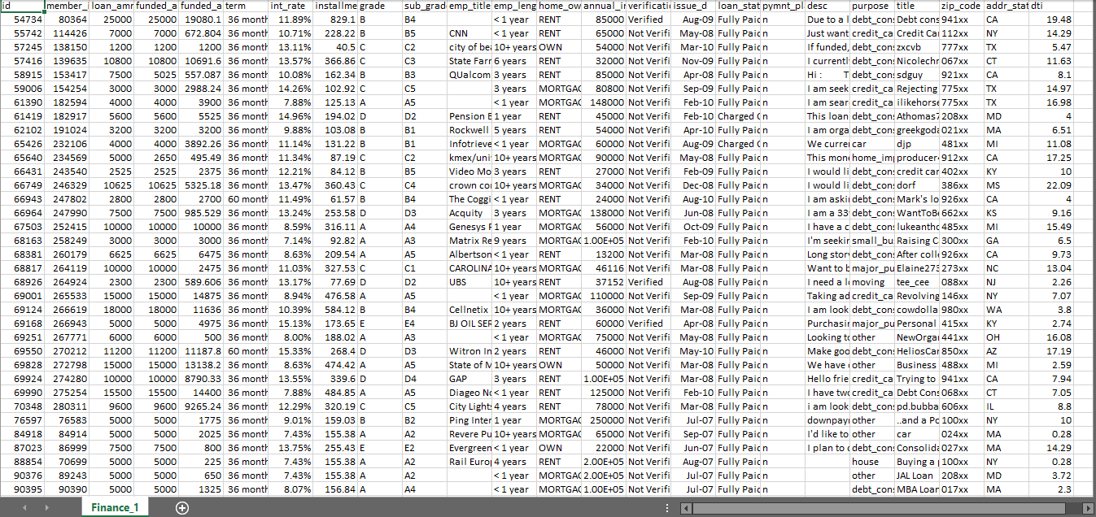
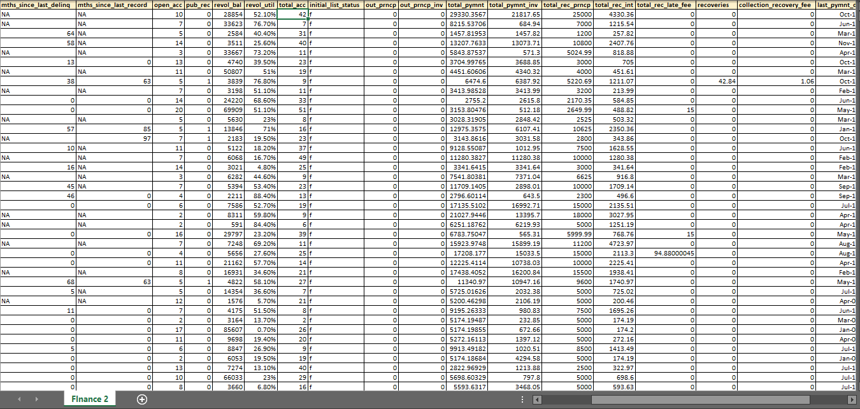
Raw Data
Finance 1
Finance 2

Slide 6
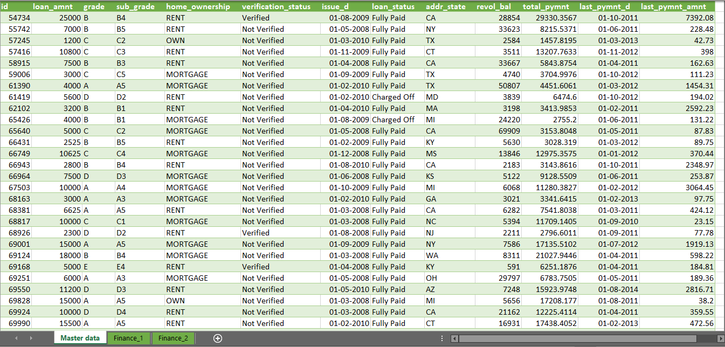
Master Data

Slide 7
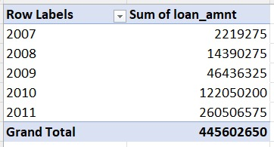
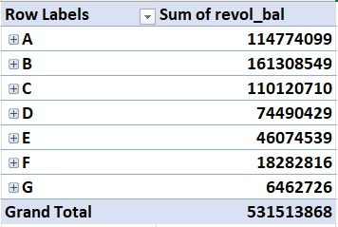
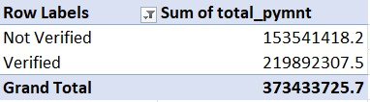
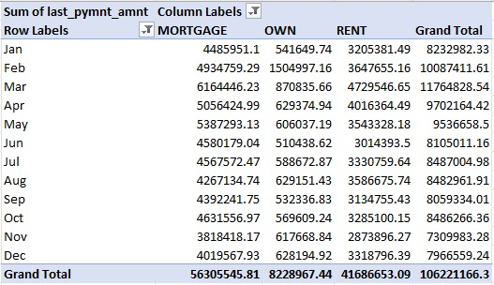
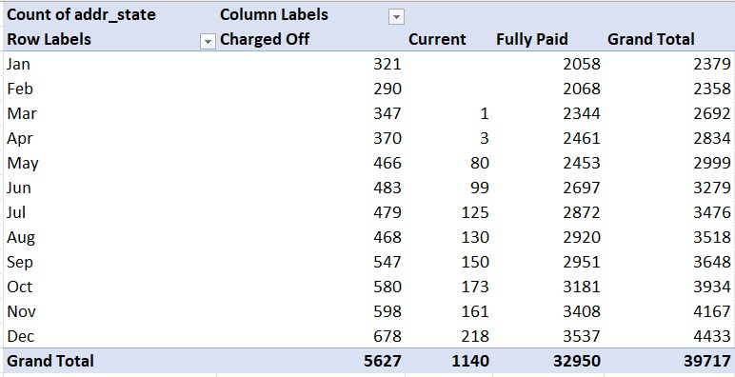
Pivot Tables

Slide 8
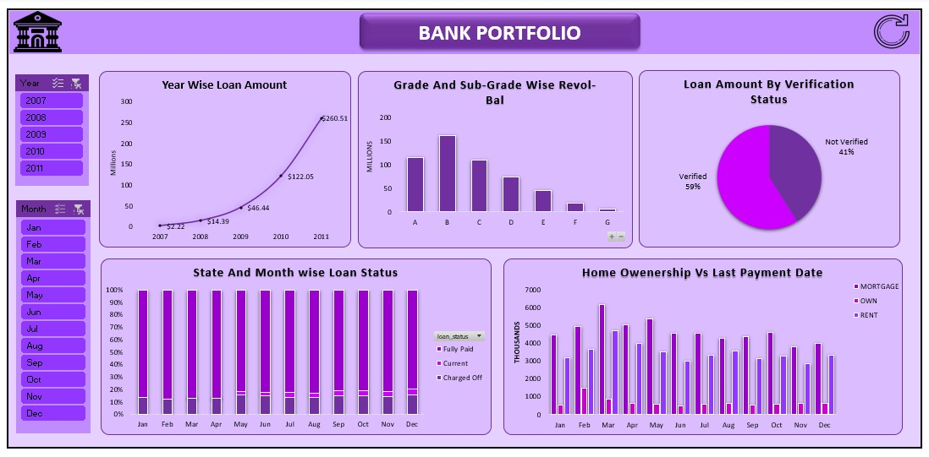
Excel Dashboard

Slide 9
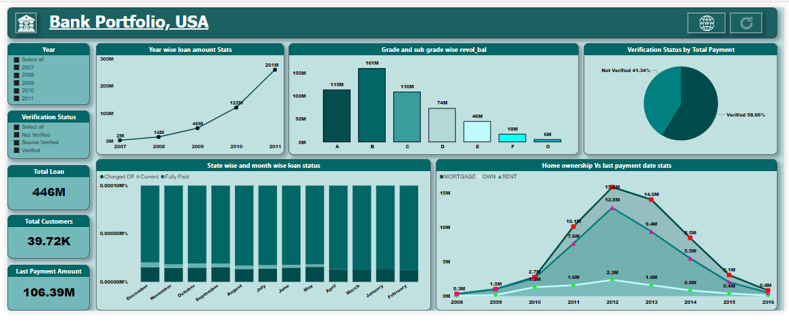
PowerBI Dashboard

Slide 10
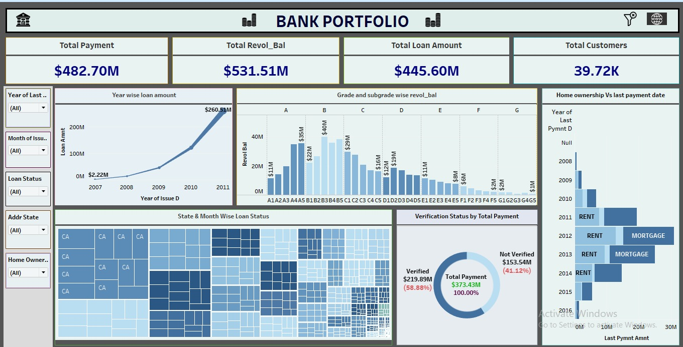
Tableau Dashboard

Slide 11
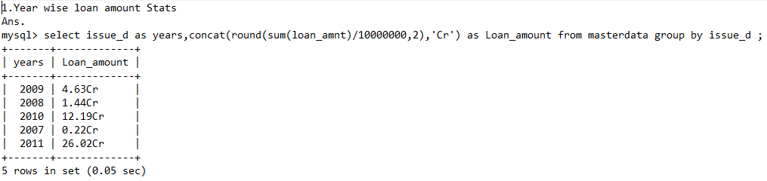
MySQL Queries

Slide 12
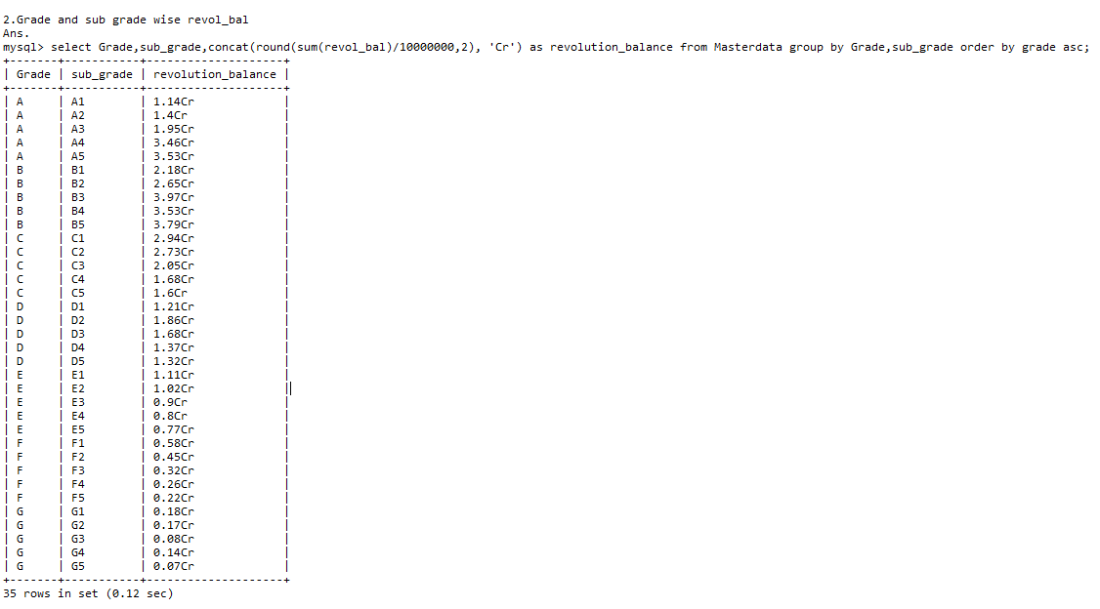

Slide 13


Slide 14


Slide 15
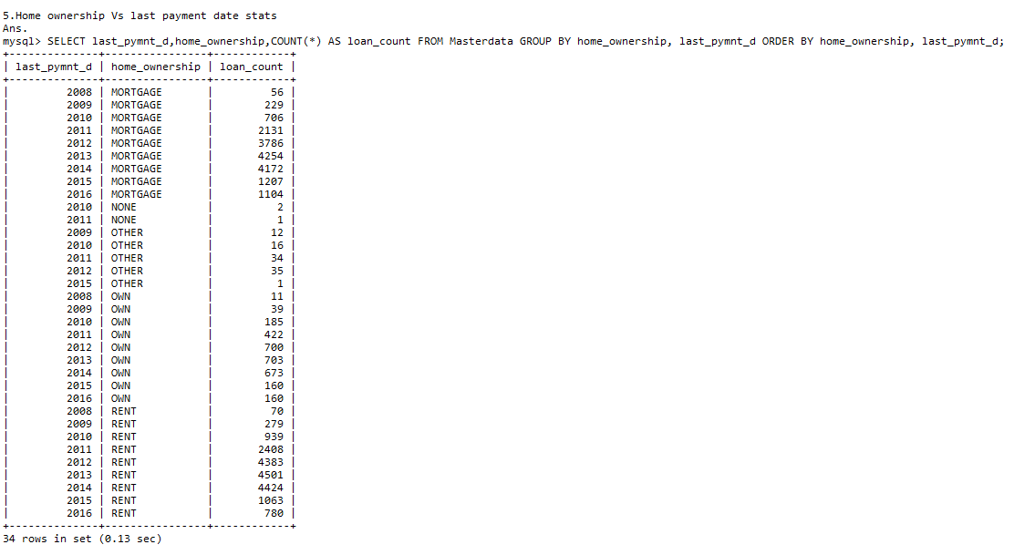

Slide 16
Key Findings
Total Payment: The total amount paid by customers is approximately $482.7 million.
Total Revolving Balance: The total revolving balance across all loans is around $531.51 million.
Total Loan Amount: The total loan amount issued to customers is $445.60 million.
Loan Growth Over Time: There has been a significant increase in the loan amounts issued over the years, with a peak in 2011 reaching $260.5 million.
State & Month-Wise Loan Status: The visual indicates that California (CA) has the highest concentration of loans, with varying loan statuses across different months.

Slide 17
Insights
Diversify Loan Portfolio: While California is a major contributor to the loan portfolio, the bank should focus on expanding its presence in other states. This will reduce dependency on a single region and spread risk more evenly.
Enhance Customer Verification Process: A significant portion of the total payments comes from verified customers, indicating the importance of thorough verification. The bank should continue to improve its customer verification processes to reduce defaults and increase trustworthiness in its customer base.
Focus on High-Growth Segments: The data indicates a surge in loan amounts issued over the years. The bank should analyze the characteristics of these high-growth segments (e.g., specific loan types, customer demographics) and focus on offering tailored products that cater to these segments.

Slide 18
Improve Mortgage Offerings: Given that mortgages make up a substantial portion of loans in recent years, the bank should continue to enhance its mortgage products. This could include offering competitive interest rates, flexible repayment options, and better customer service to attract more customers.
Leverage Data Analytics for Risk Management: The bank should invest in advanced data analytics tools to better predict and manage risks. By analyzing patterns in loan defaults and payment delays, the bank can proactively address potential issues and improve overall loan performance.
Customer Retention and Loyalty Programs: The bank should introduce programs that reward loyal customers and incentivize timely payments. This could include interest rate discounts, cash-back offers, or loyalty points that can be redeemed for various benefits.
Explore Digital Transformation: As the financial industry increasingly moves towards digital solutions, the bank should invest in digital platforms for loan processing, customer service, and data management. This will improve efficiency, reduce operational costs, and enhance the customer experience.

Slide 19
THANK YOU

